Slide 1

Software Testing
-By K. Eesha Apoorva

Slide 2
Economics of Testing
Understand where defects originate
Learn about the 1:10:100 rule
Learn how to make the most of your testing investment
Where testing resources are used
The relative cost of fixing defects

Slide 3
Process of Software Testing
There are 11 steps to conduct Software Testing
Assess Development Plan and Status
Develop the Test Plan
Test Software Requirements
Test Software Design
Build Phase Testing
Execute and Record Result
Acceptance Test
Report Test Results
The Software Installation
Test Software Changes
Evaluate Test Effectiveness

Slide 4
Software Testing(Then and Now)
Software Testing-then(past)
Till the late ‘70s and ‘80s, testing was seen as exercise to ensure that the software works as per the specified requirement.
It was then extended to find the errors, besides ensuring the proper functioning of the software.
Software Testing-now(present)
There are many different types of software tests, each with specific objectives and strategies.
Like Agile and DevOps, Test Automation, API and Services Test Automation and Artificial Intelligence for Testing

Slide 5
Scope of Software Testing
Execution of that code in various environments and scenarios.
Examine the aspects of the code:
1) Does the software do perform the executed task
2) Function according to the specified functions
Does the software do perform the executed task or not

Slide 6
Factors influencing Scope of Testing
1) Planning :
Planning in software testing is essential.
Clear understanding of risks and amount of work may improve productivity.
2) Time :
It is important to be careful with test estimation.
Required for quality testing depends on skills, testing approaches and techniques.

Slide 7

3) Size and Complexity :
It have a no. of features that require more skills and time for testing.
New functionality needs to be covered by tests.
4) Documentation :
It may improve Quality Assurance services.
Carefully describe the bugs in detail in testing documentation.

Slide 8

5) Skills:
Testing team is connected with production,
that is why Skills of all the team are important.
6) Team interaction:
Testing depends on development team.
Communication with team allows testers to improve their skills.

Slide 9

Methodology:
It is used in project determines how testing process will go further.
8)Trends:
Trendy technologies like AI and loT may change testing techniques.

Slide 10
Risk based Testing
Projects having time, resource, budget constraints, etc.
Projects where risk based analysis can be used to detect vulnerabilities to SQL injection attacks.
Security Testing in Cloud Computing Environments.
New projects with high risk factors like Lack of experience with the technologies used, Lack of business domain knowledge.
Incremental and iterative models, etc.

Slide 11
Project Risk VS Product Risk
Product Risk
Project Risk
Product risk is the risk associated with the software or system, the possibility that software or system may fail to satisfy end user/customers expectations is known as product risk.
As we know that testing is an activity and so it is subject to risk which may endanger the project, so we can say that the risks associated with the testing activity which can endanger the test project cycle is known as project risk.

Slide 12
Independent Testing
Independent Testing is a collection of tests done by a specific corporation, person, or agency that software system according to desired requirements.
This can be connected and used for all sorts of web applications, iOS, and Android platforms.
This also consists of some third-party testing referred to as contrast testing or evaluation facilities.

Slide 13
Need of Independent Testing
It determines that work is done according to the needs of the specification, regulation, or not.
It figures out if the upcoming products/programs are on track.
Supplies standard data for scientific engineering and Quality Assurance functions.
Validate suitable for end-user or not.
Provides a medium for technical communication.
Gives evidence in legal proceedings, product claims, etc.

Slide 14
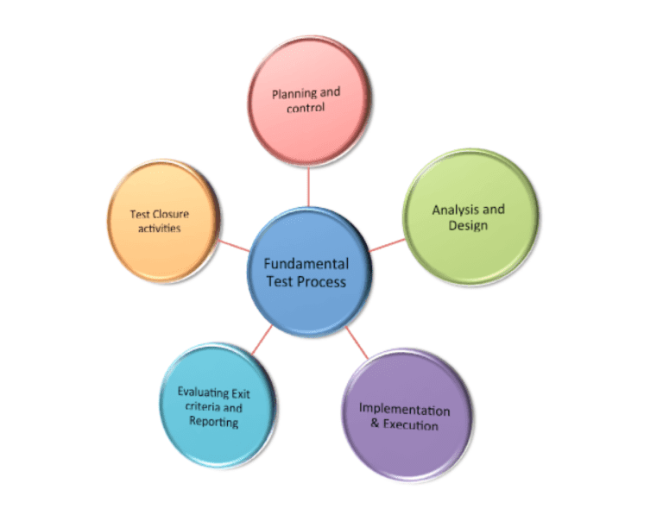
Fundamental Test Process
Test Process activities are :
Planning and Control
Analysis and Design
Implementation and Execution
Evaluating test exit criteria and Reporting
Test Closure activities

Slide 15

Attributes of a Good Tester
Creative mind
Skills
Good listener
Good learner
Understand Priorities
Team Interaction
Ability to ask questions
Ability to report
Ability to identify and manage risks

Slide 16
Psychology of Testing
Psychology of testing is a type of testing which is fully depends on the mindset of developers and tester.
When we are building the software, we working positively towards the software never think about negative things.
Mindset should be different while testing and reviewing developing software.
With the correct mindset programmer can test their own code.
At a certain point independence tester often makes the tester more effective to finding defects.

Slide 17
Code of ethics for Tester
Public: During the process of software development and testing, the public interest and benefit should be considered before corporate and personal gain.
Client & Employer: Apart from public interest, the testers should consider the interest of their client and employer while conducting tests on the software
Product: The most important factor that needs consideration during the process of software testing is the product itself.

Slide 18
Judgement: The testes should maintain integrity and independence while making judgments regarding the process of testing or any other aspects related to it.
Management: Here, the team managers and leads should take the responsibility and ethical steps to manage the process of software testing, development, and maintenance.
Profession: The team of testers should follow the set f values, principles, and standards and advance the integrity of their profession.

Slide 19
Limitations of Software Testing
One cannot test a program completely.
One can only test against system requirements.
Exhaustive (total) testing is impossible in present scenario.
Time and budget constraints normally require very careful planning of the testing effort.
Compromise between thoroughness and budget.
Test results are used to make business decisions for release dates.
Even if you do find the last bug, you’ll never know it.
One will run out of time before you run out of test cases.

Slide 20

Thank you

